Slide 1
Video Analytics Solution Proposal
© Copyright by Customindz Limited

Slide 2

Trackable
Centralized
Automate
World Leading AI Company
In Construction and Engineering Industry

Slide 3

Why viAct ?
Leading AI based Monitoring Solution
Pioneer RnD Firm
Wide AI Hosting Options
Cloud, On-Prem & Hybrid
Privacy
GDPR Compliance
Simple UX + No Code AI
Instant Deployment in Real Time
100+ Deployments
in Construction Domain
Worldwide
Awards & Recognitions

Slide 4








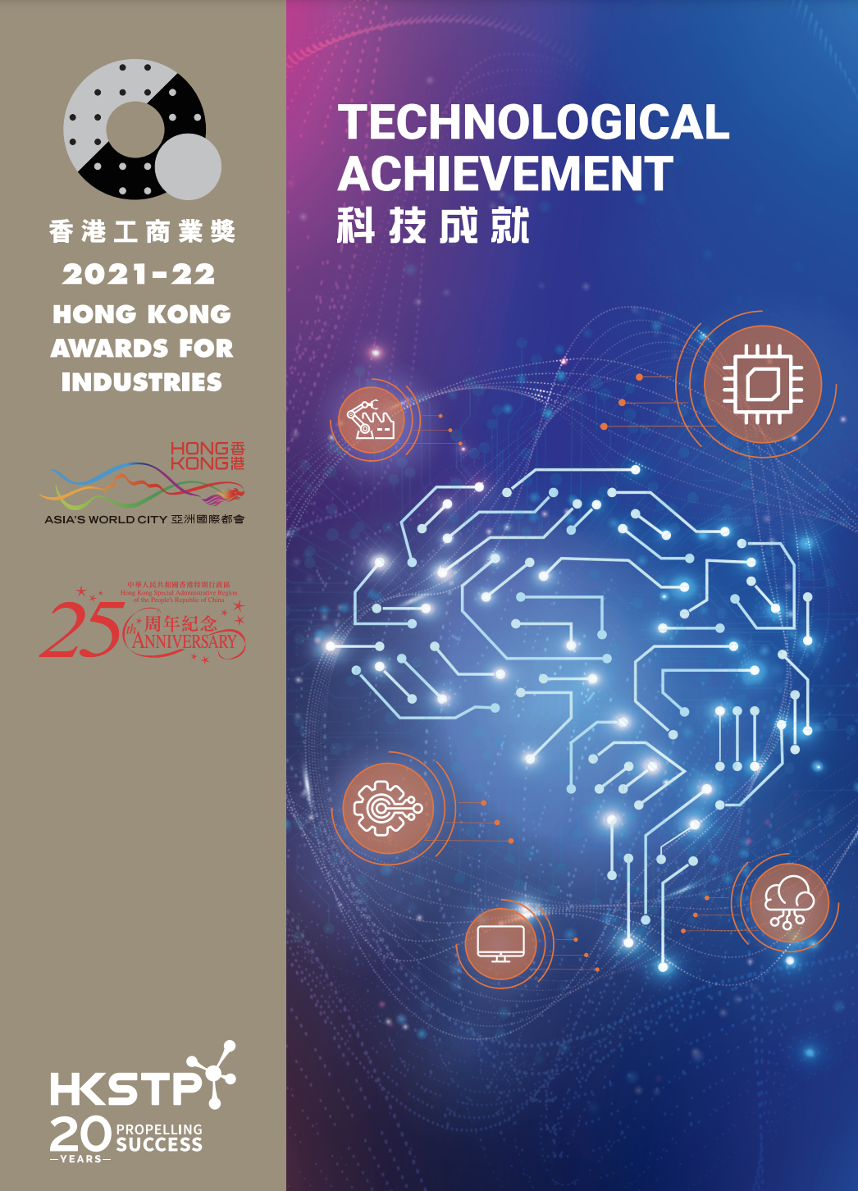



International Recognitions
2023 Deloitte Hong Kong Technology Fast Award
High Impact Award
2023
Technology Pioneers 2023
Smart City
Sector Winners
2023 Winner
International Track
Leading PropTech 50
2022 KPMG China
Top 6 finalist
Smart City Idols

Slide 5
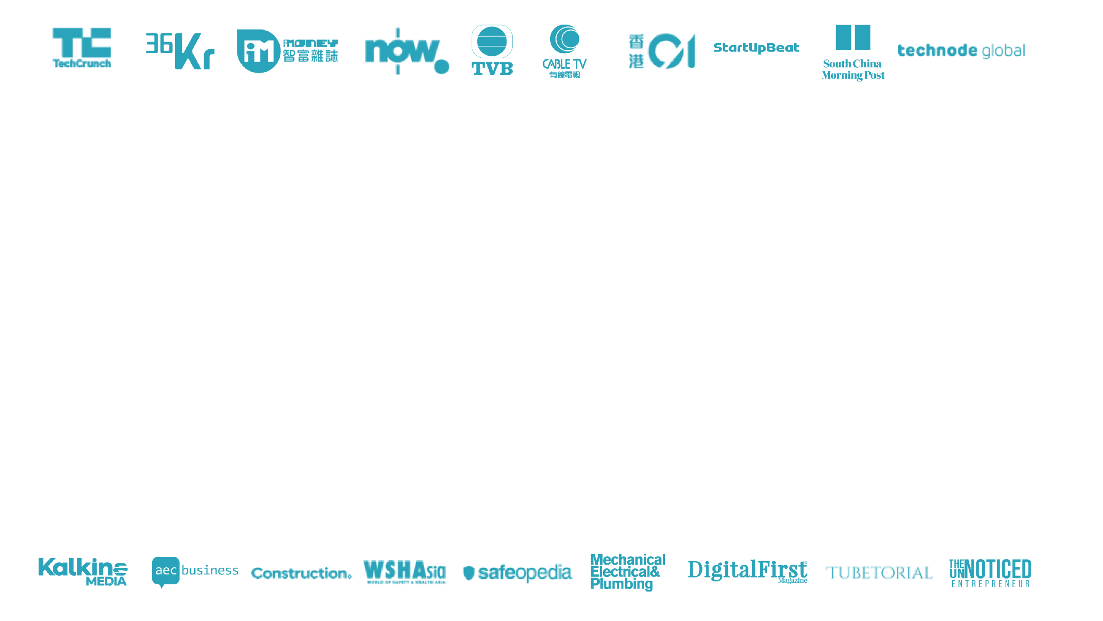
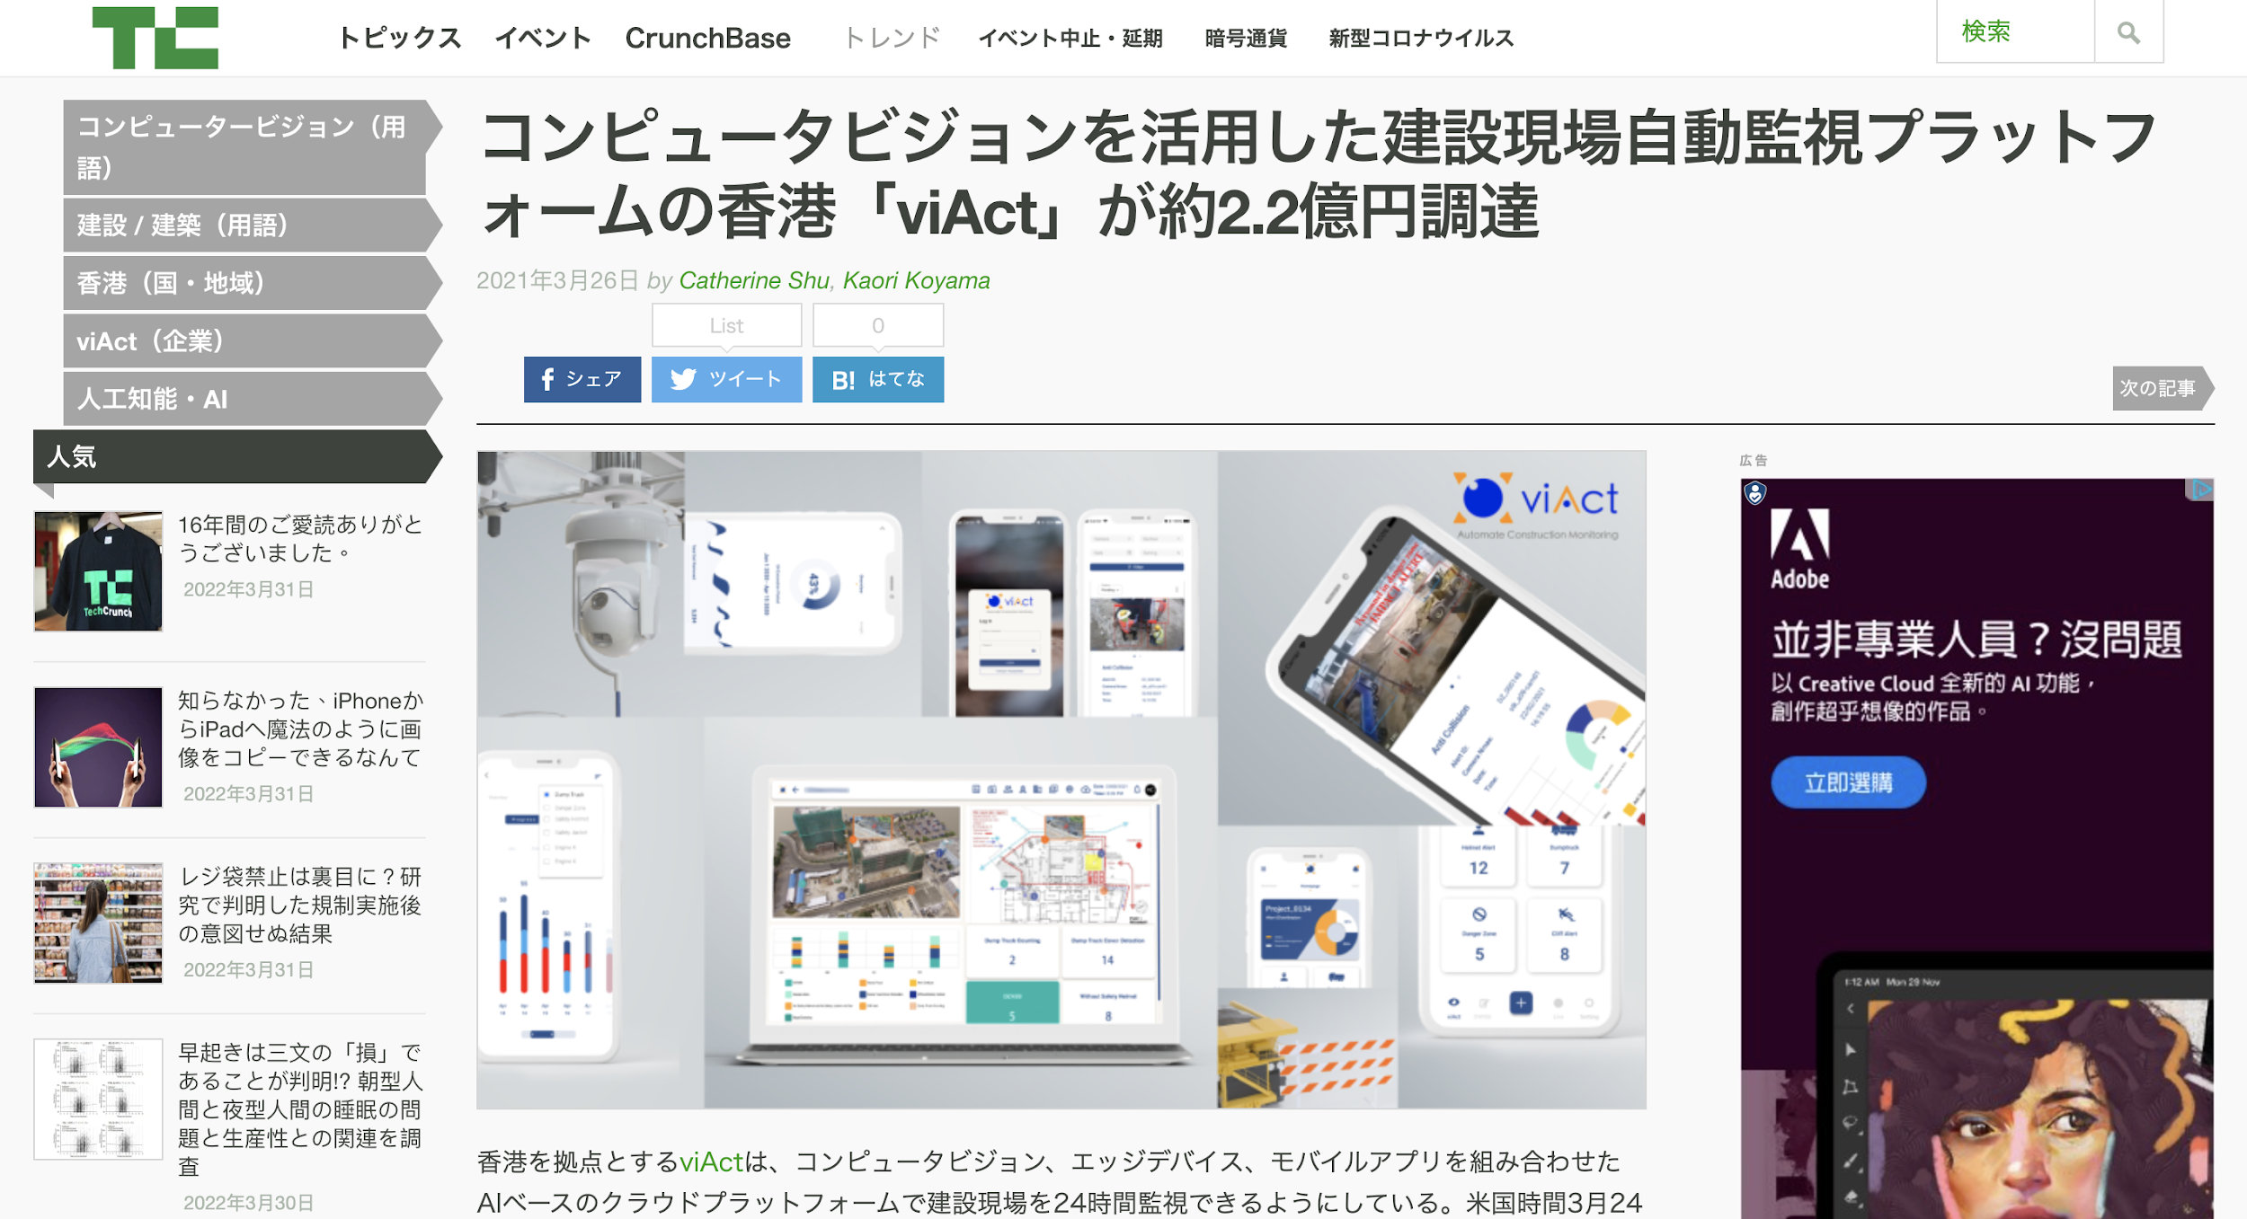
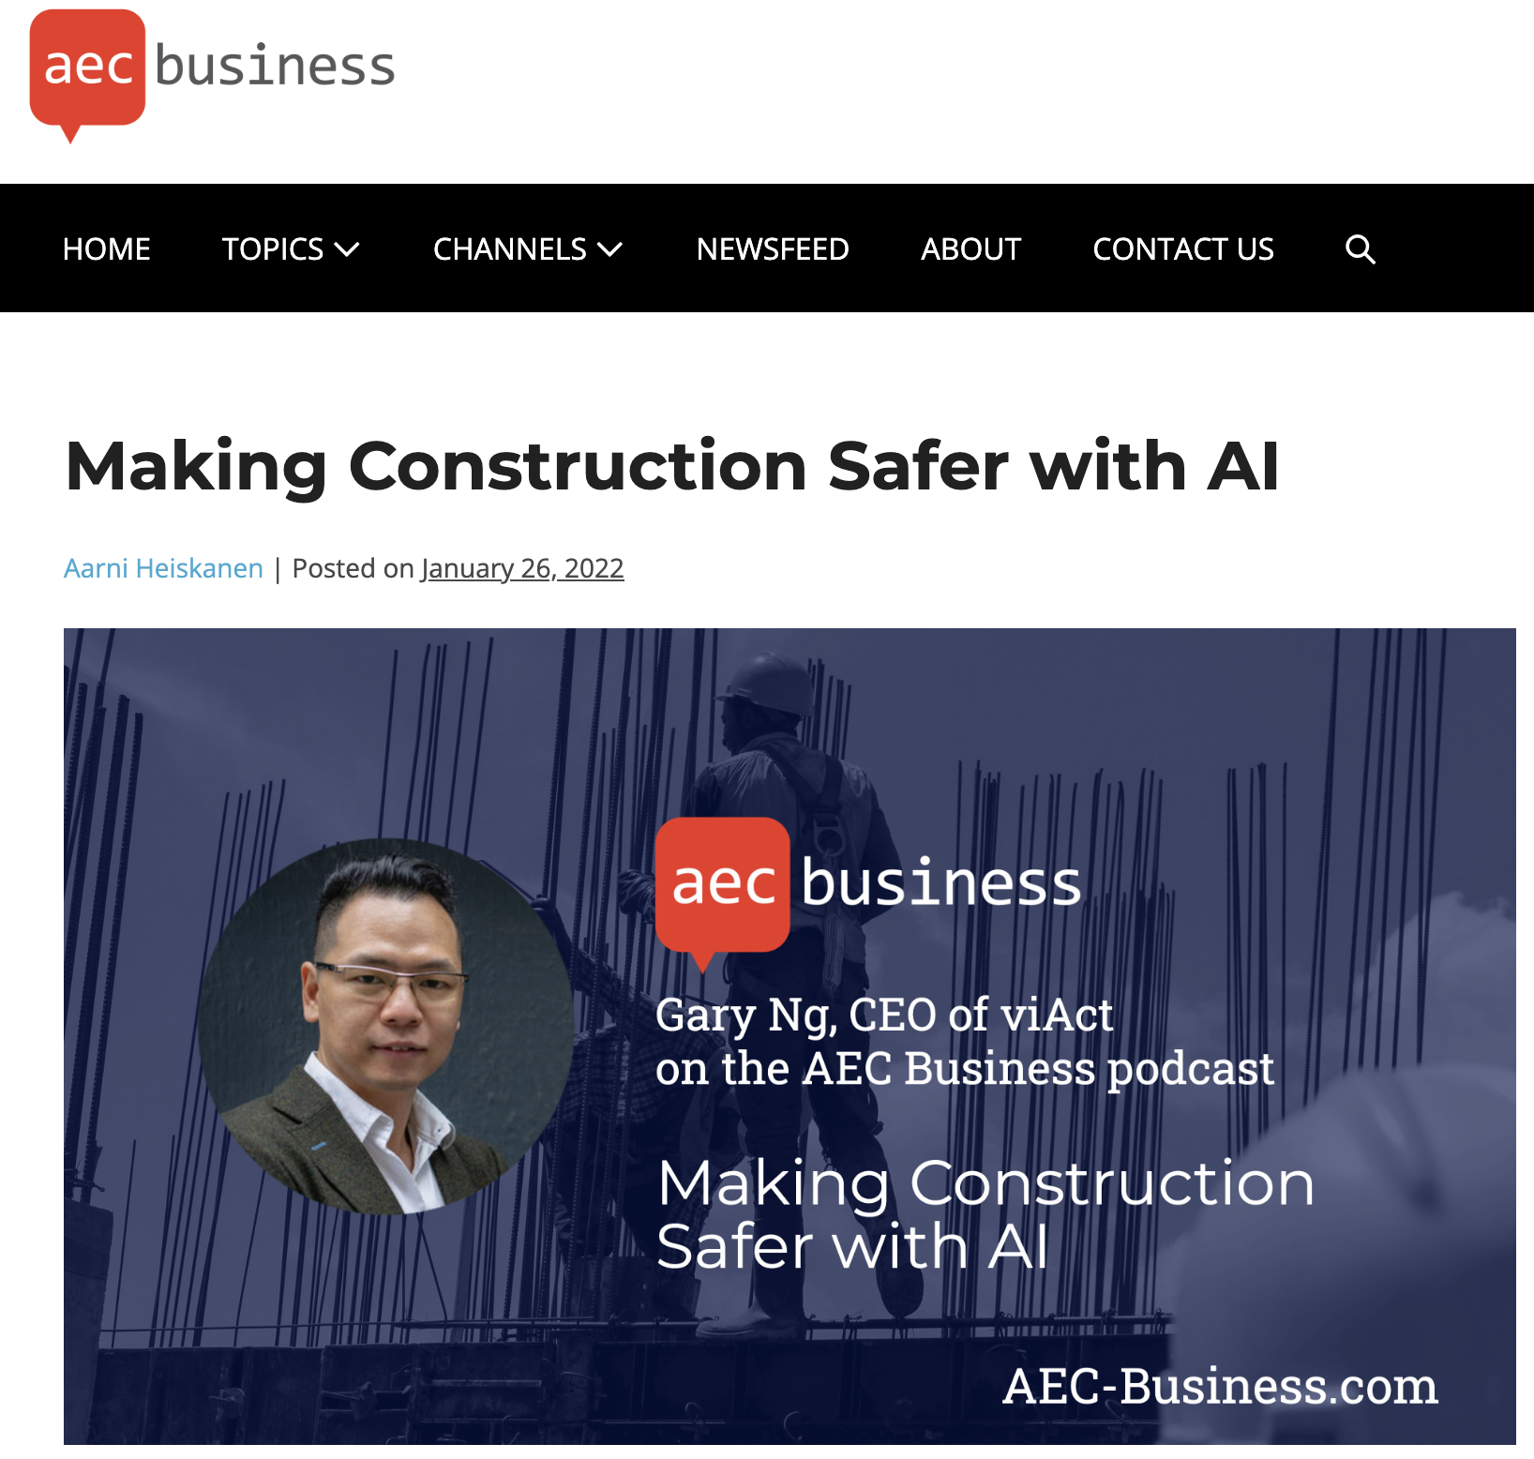
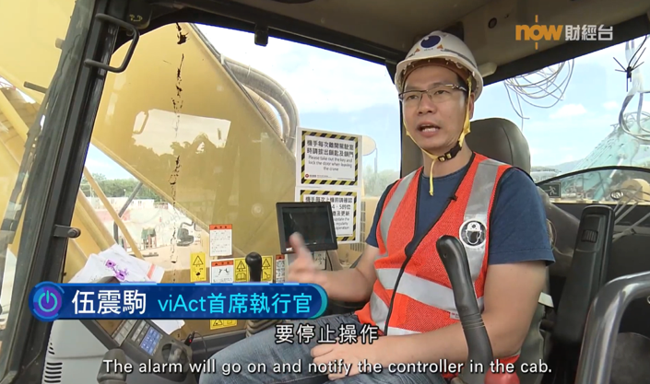

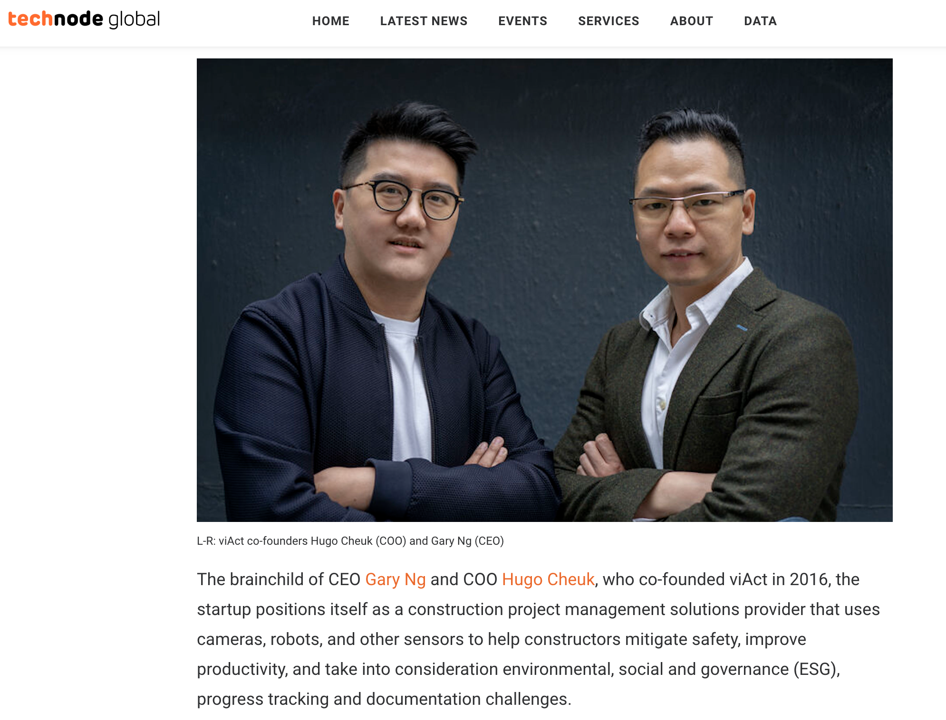
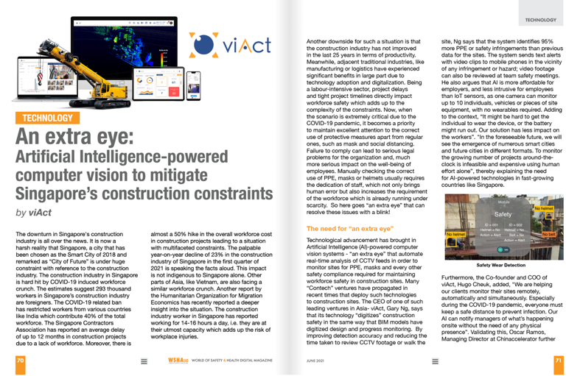

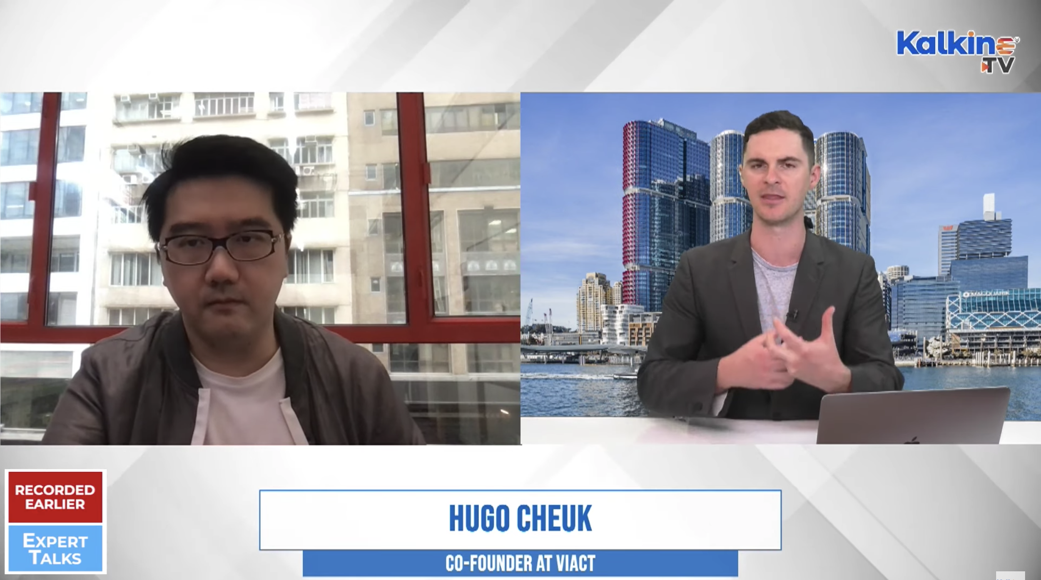
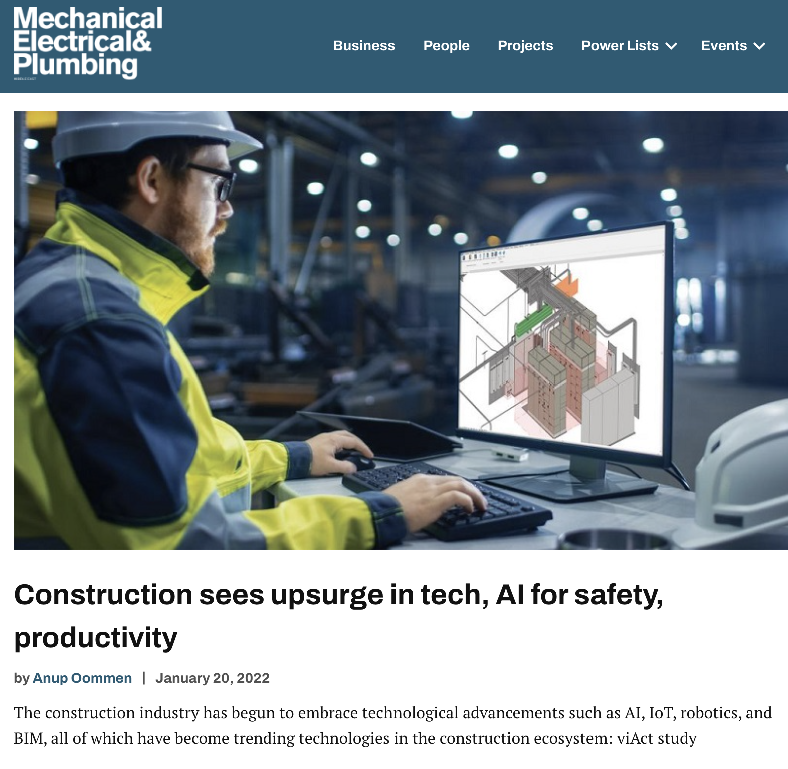
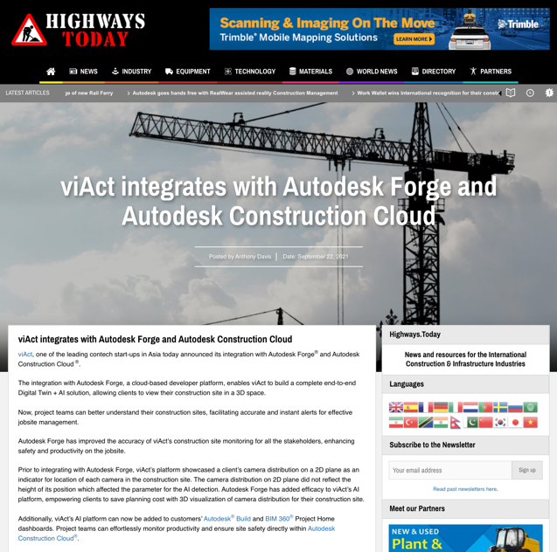
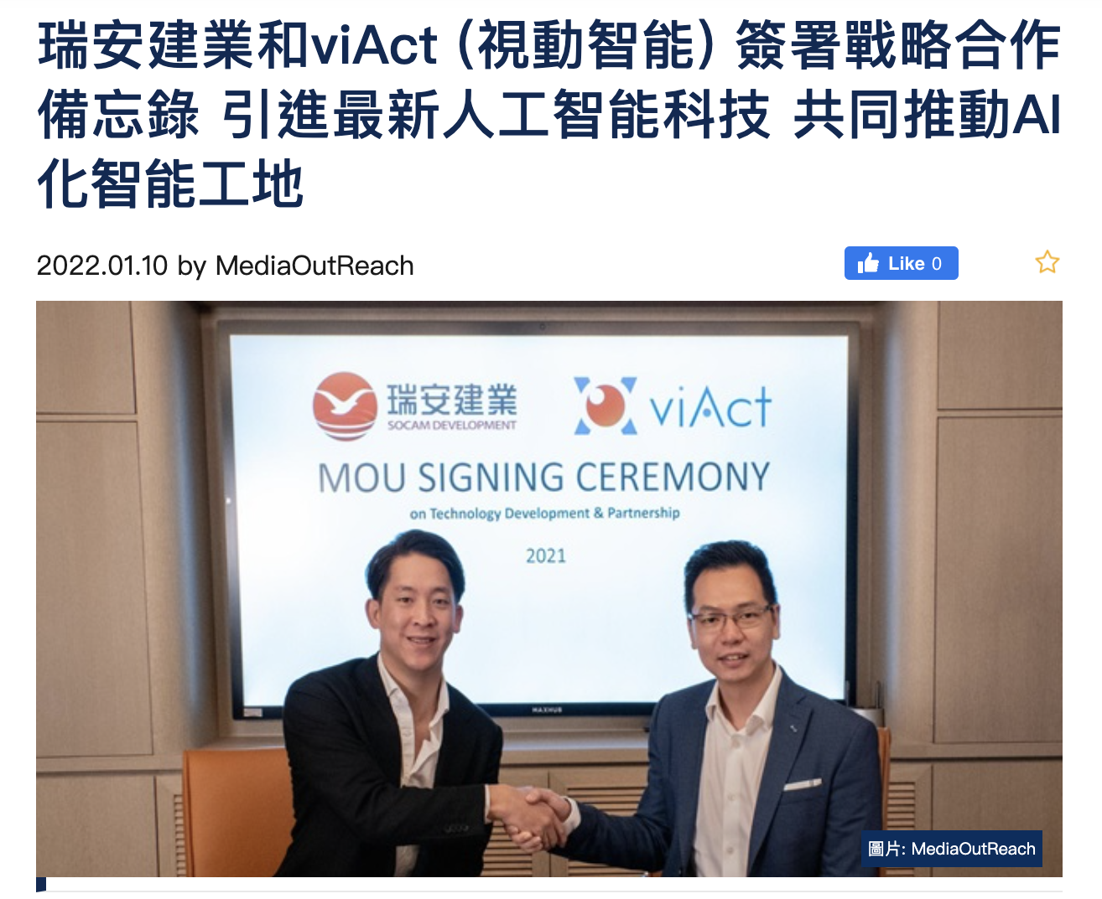
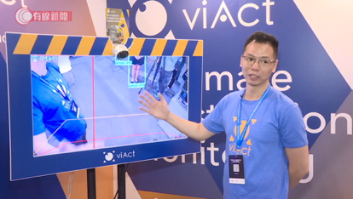
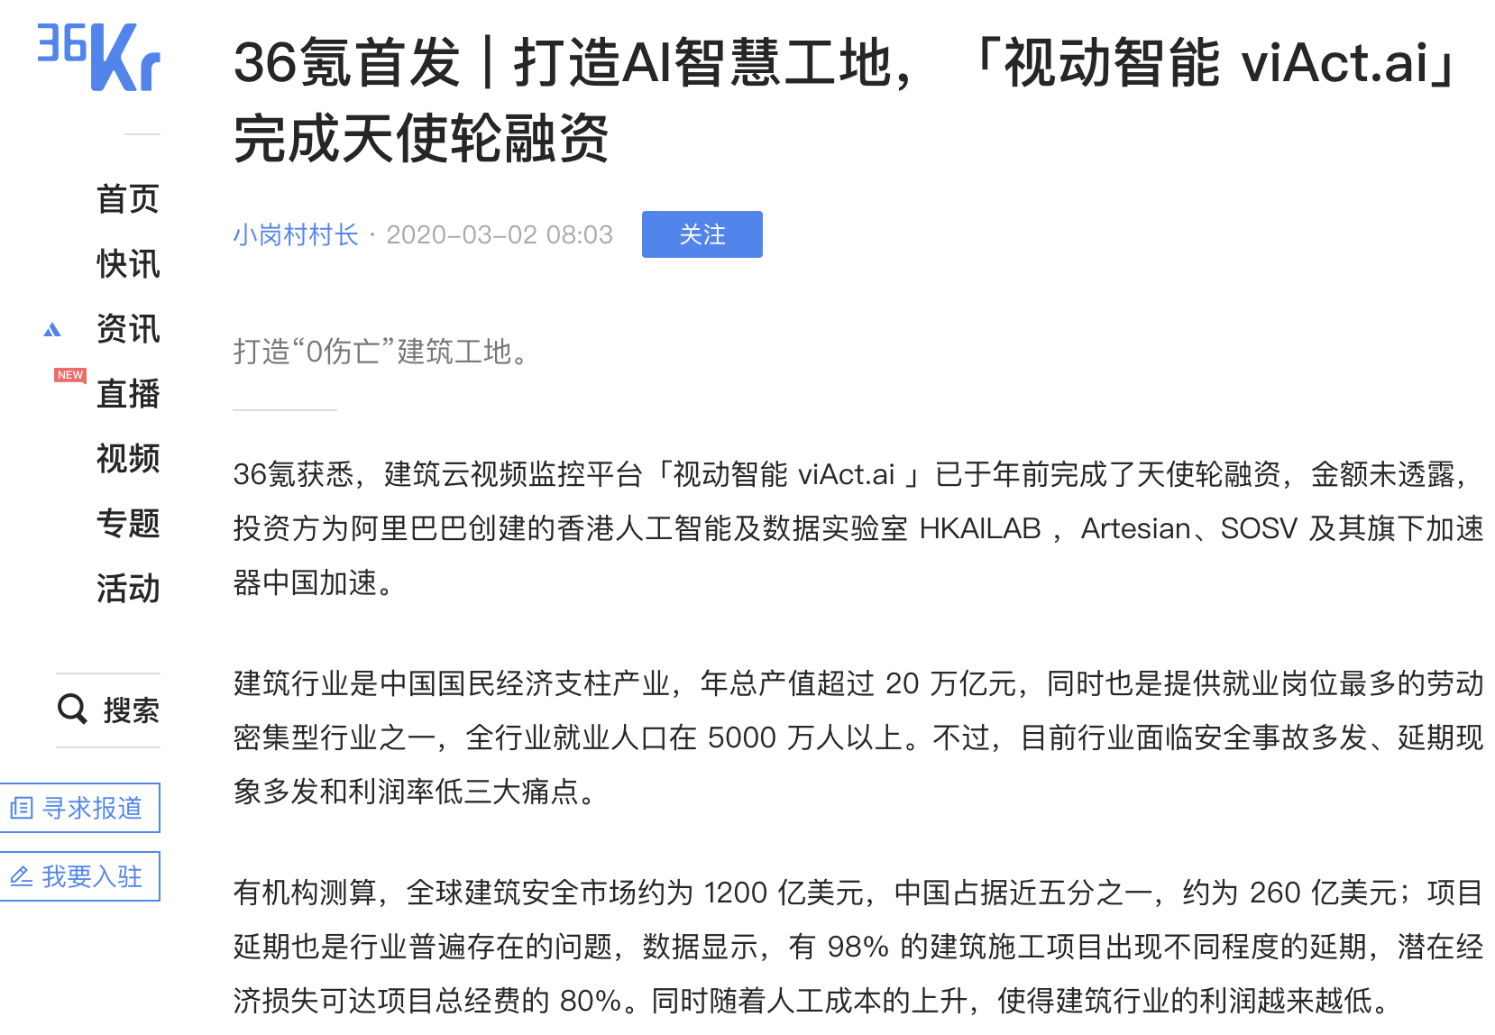

Slide 6
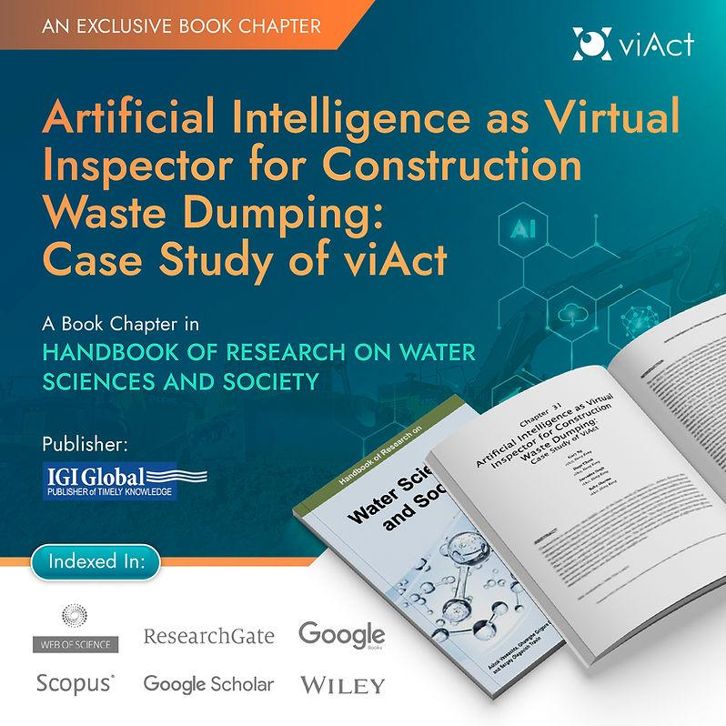
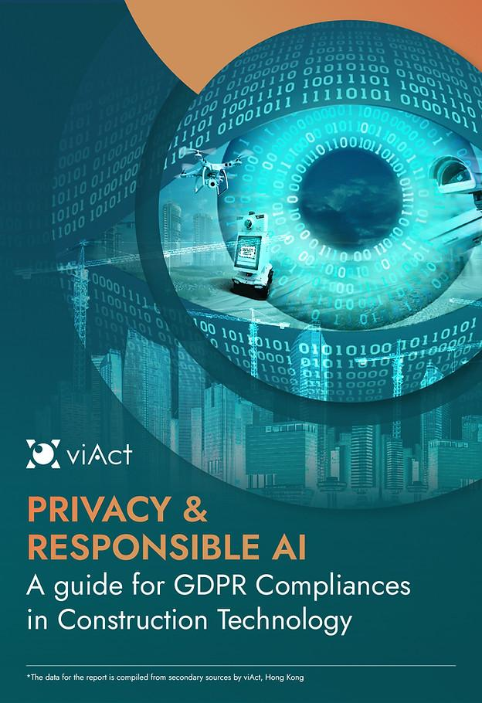

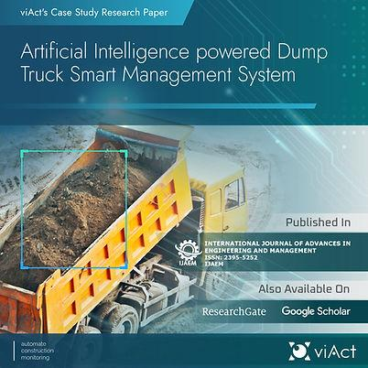
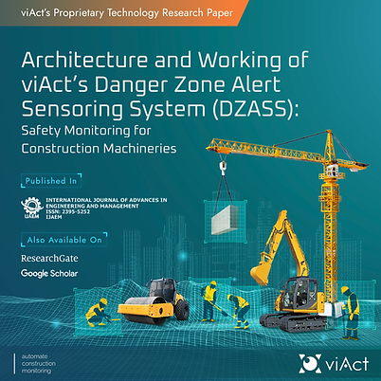
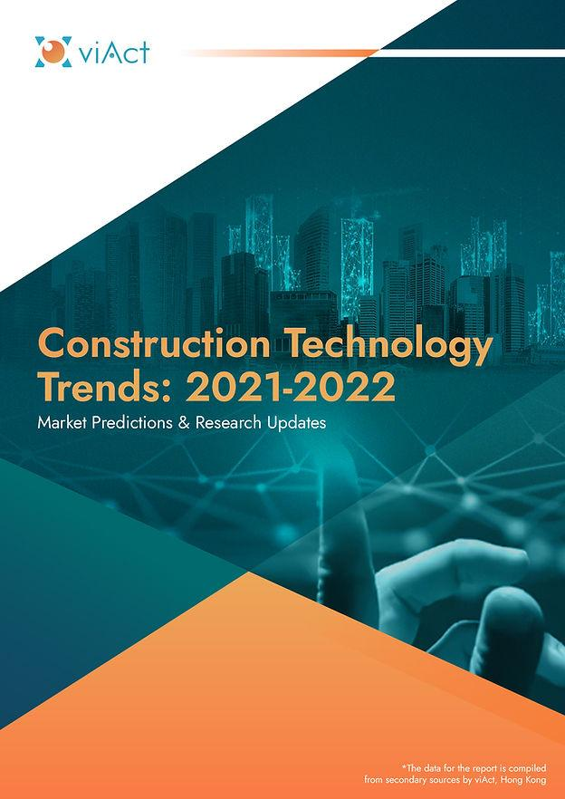

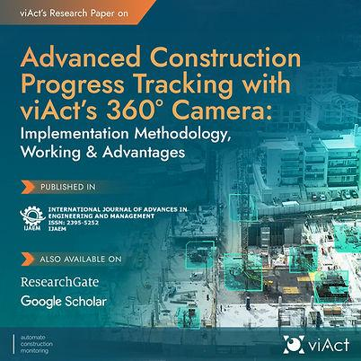

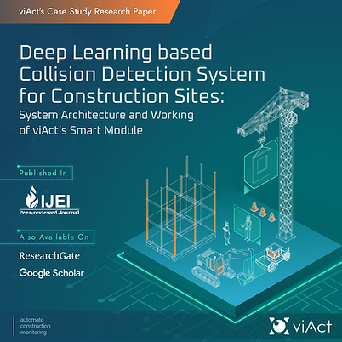
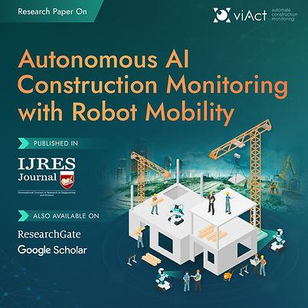
No.1 Construction
AI Research Paper
Publisher

Slide 7






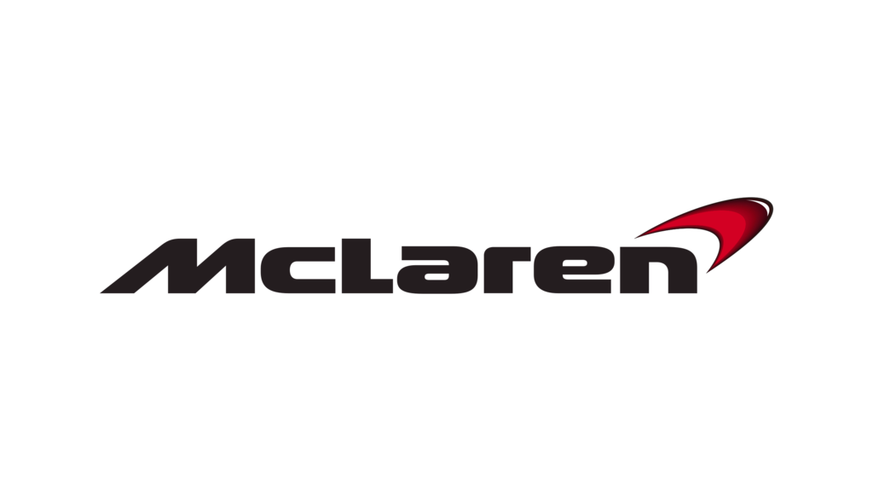



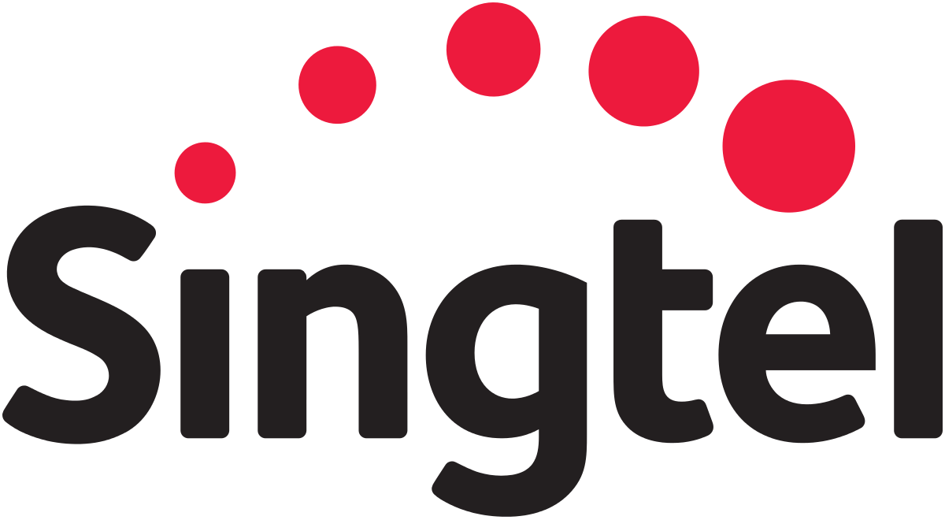





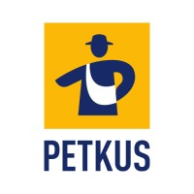



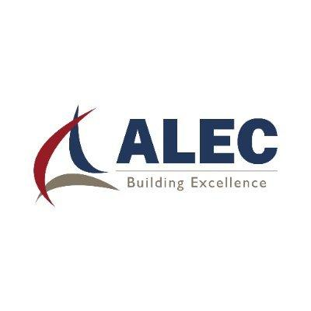

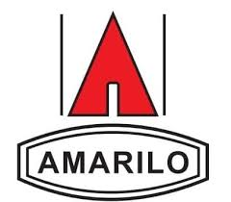
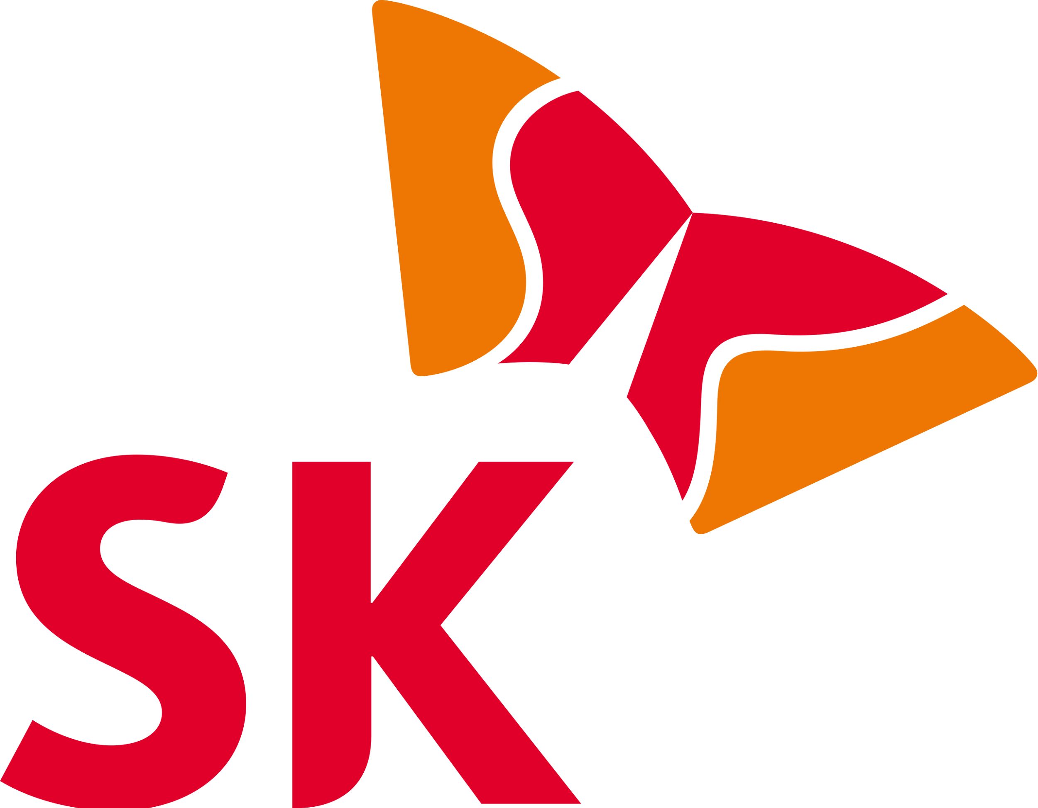








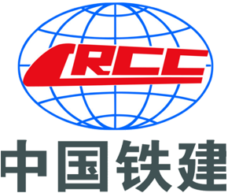
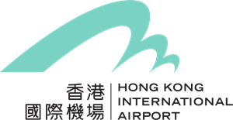

Global Industrial & Innovation Leaders Trust Us

Slide 8
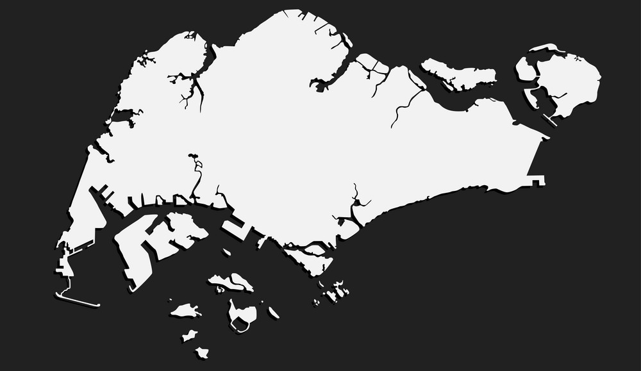



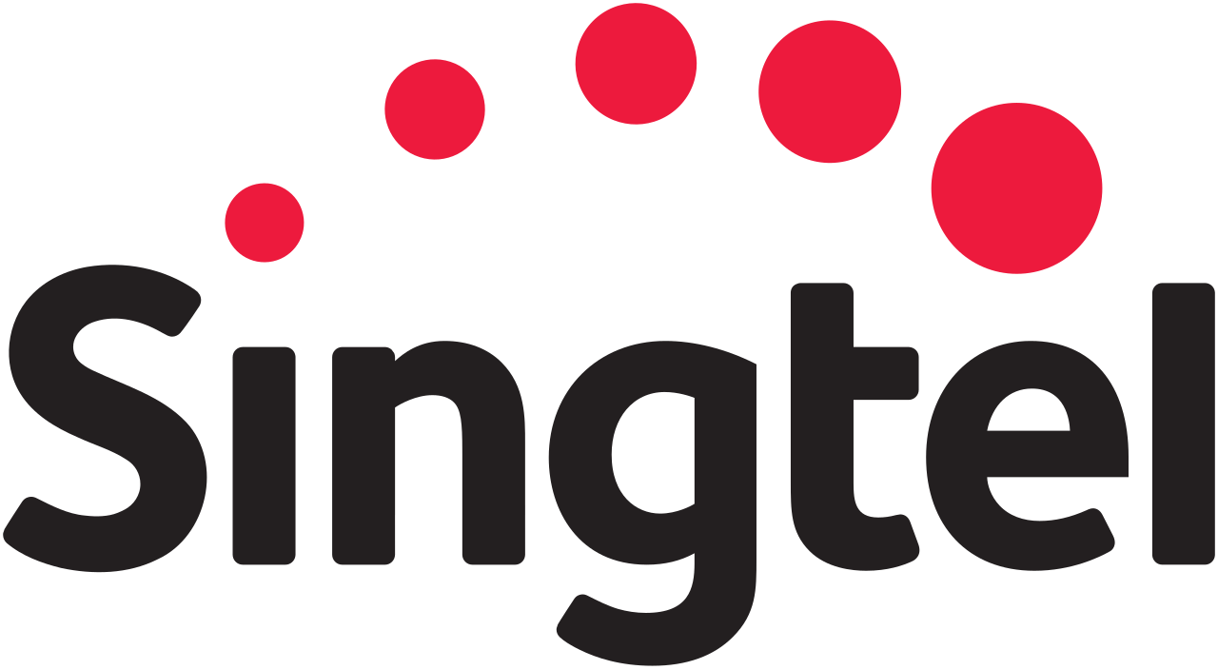


Singapore Project Experience

Slide 9










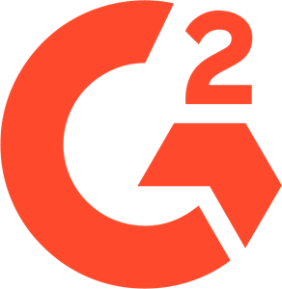


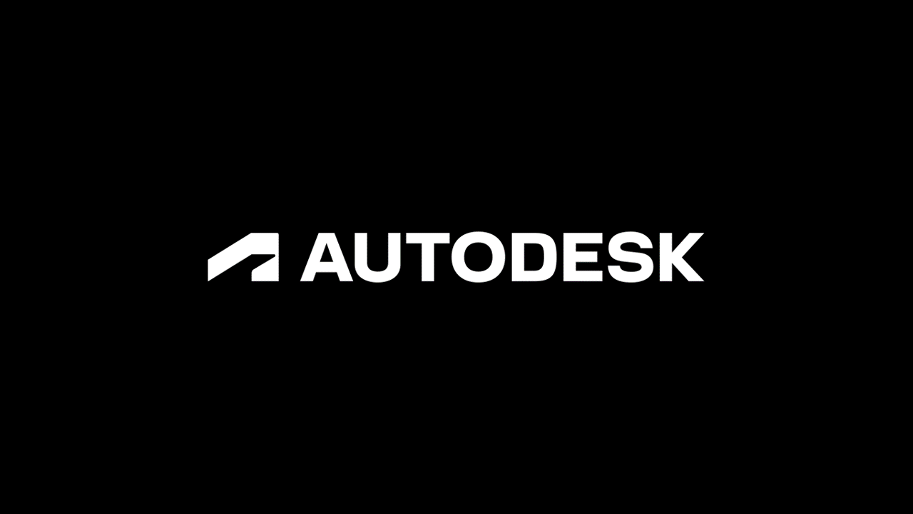


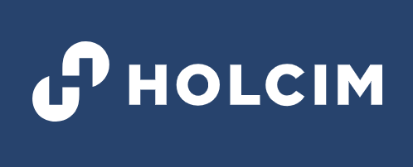





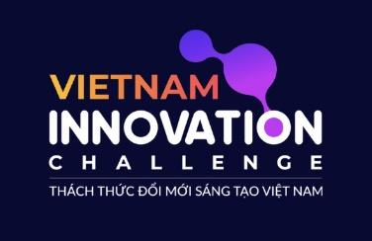


Global Footprint

Slide 10
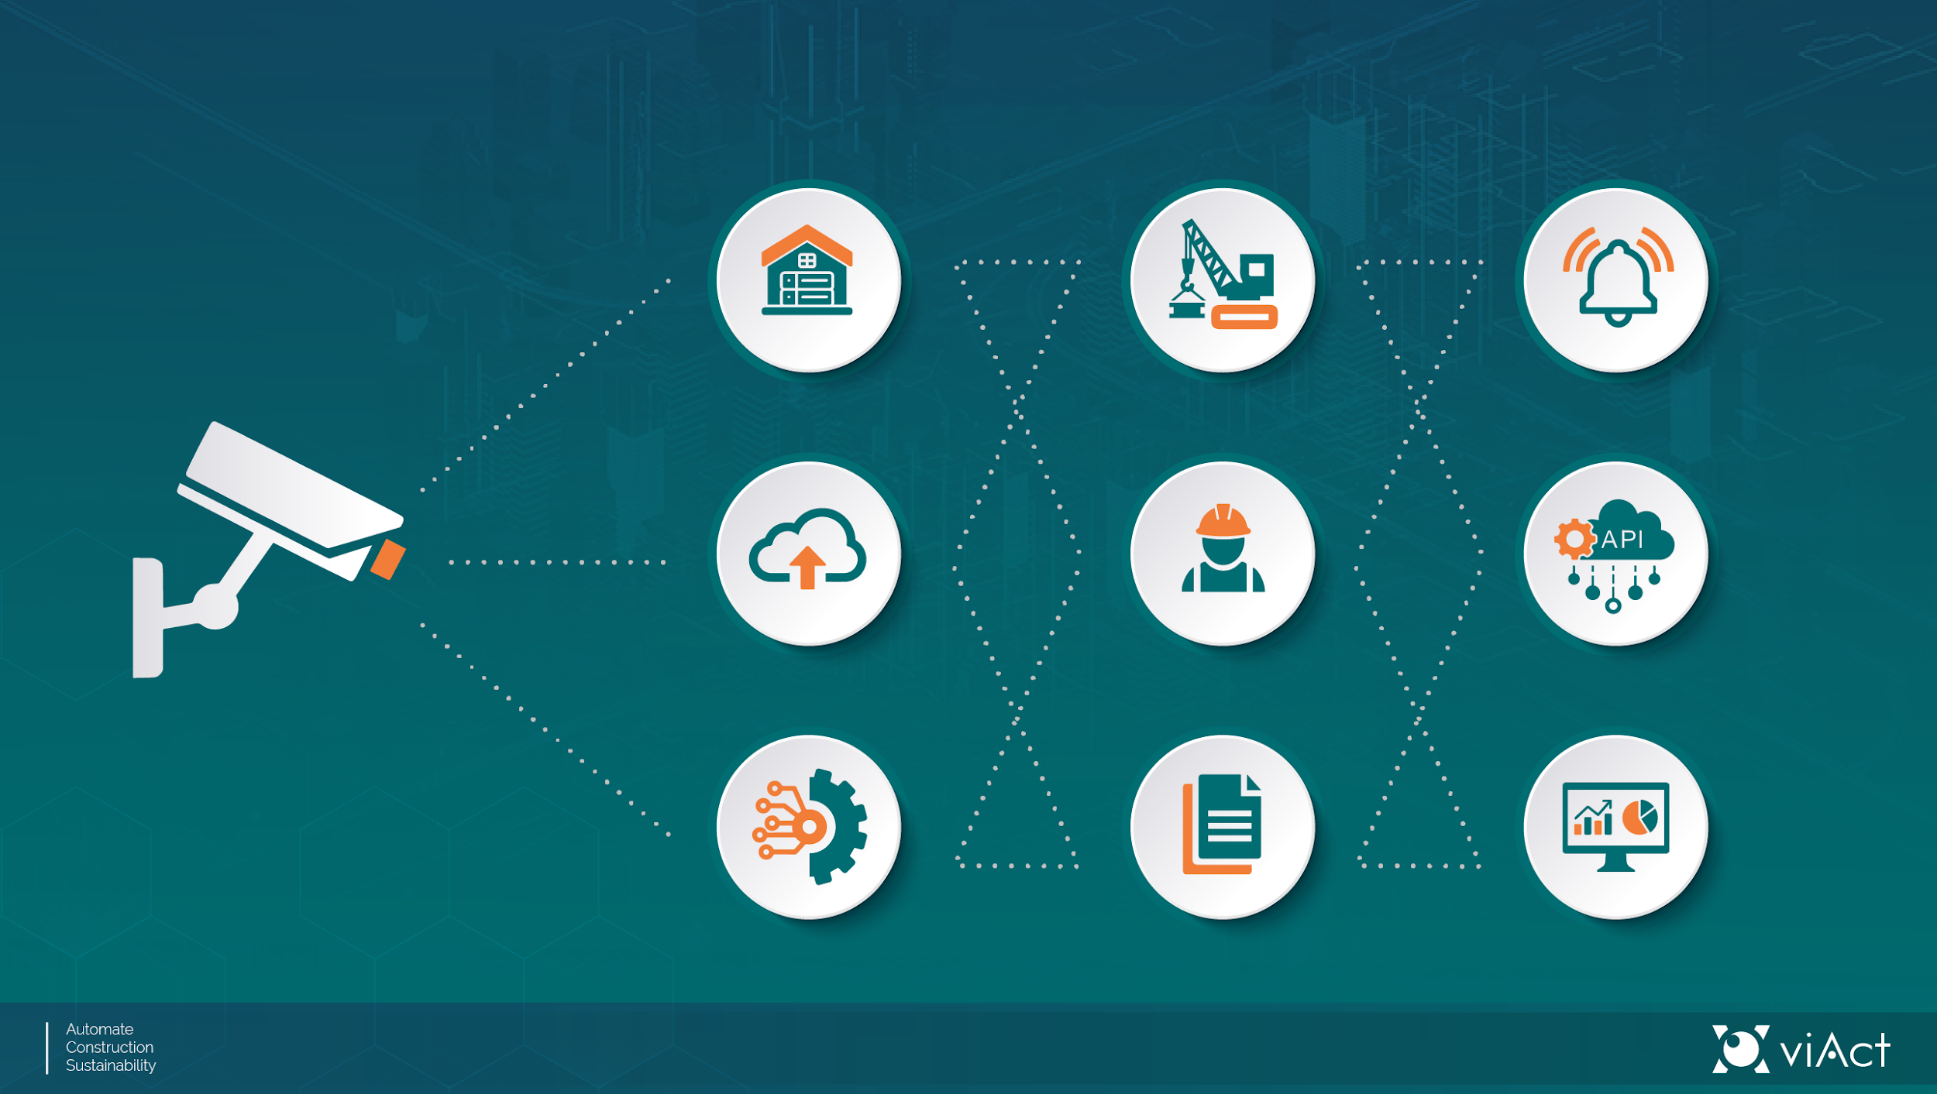
How viAct Works?
Deep Learning Analysis
On Premise
Machinery
Alarm
On Cloud
Worker
API
Any IP Camera & CCTV installed on-site
(REAL TIME)
By Hybrid
Material
Dashboard
Notes:
Technically, viAct integrates with any IP camera / CCTV. Feeds are analyzed via Edge or Cloud deep-learning engines; events generate alarms to dashboards, mobile apps and on-site buzzers. We support hybrid deployments (on-premise + cloud) for sites with strict network/security constraints. Typical camera spec: 1080p @25fps, ~2 Mbps RTSP feed; NVRs and CPEs can be used where network is limited.

Slide 11
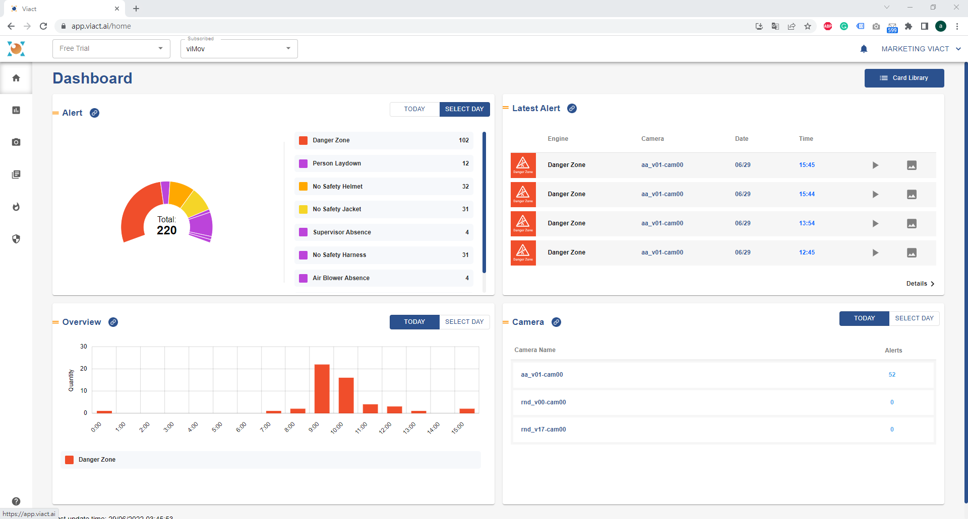
viAct Dashboard
Home Page: Event Analysis

Slide 12

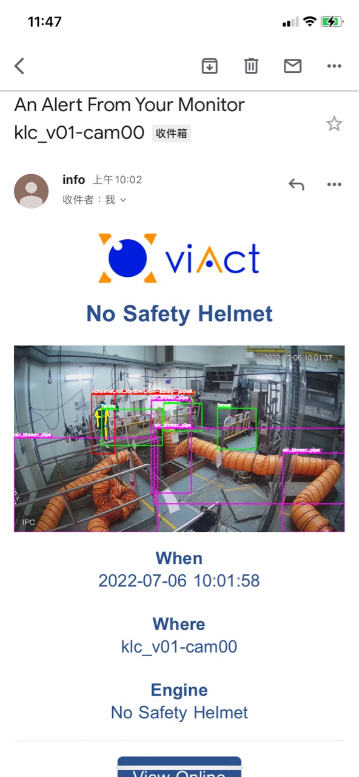
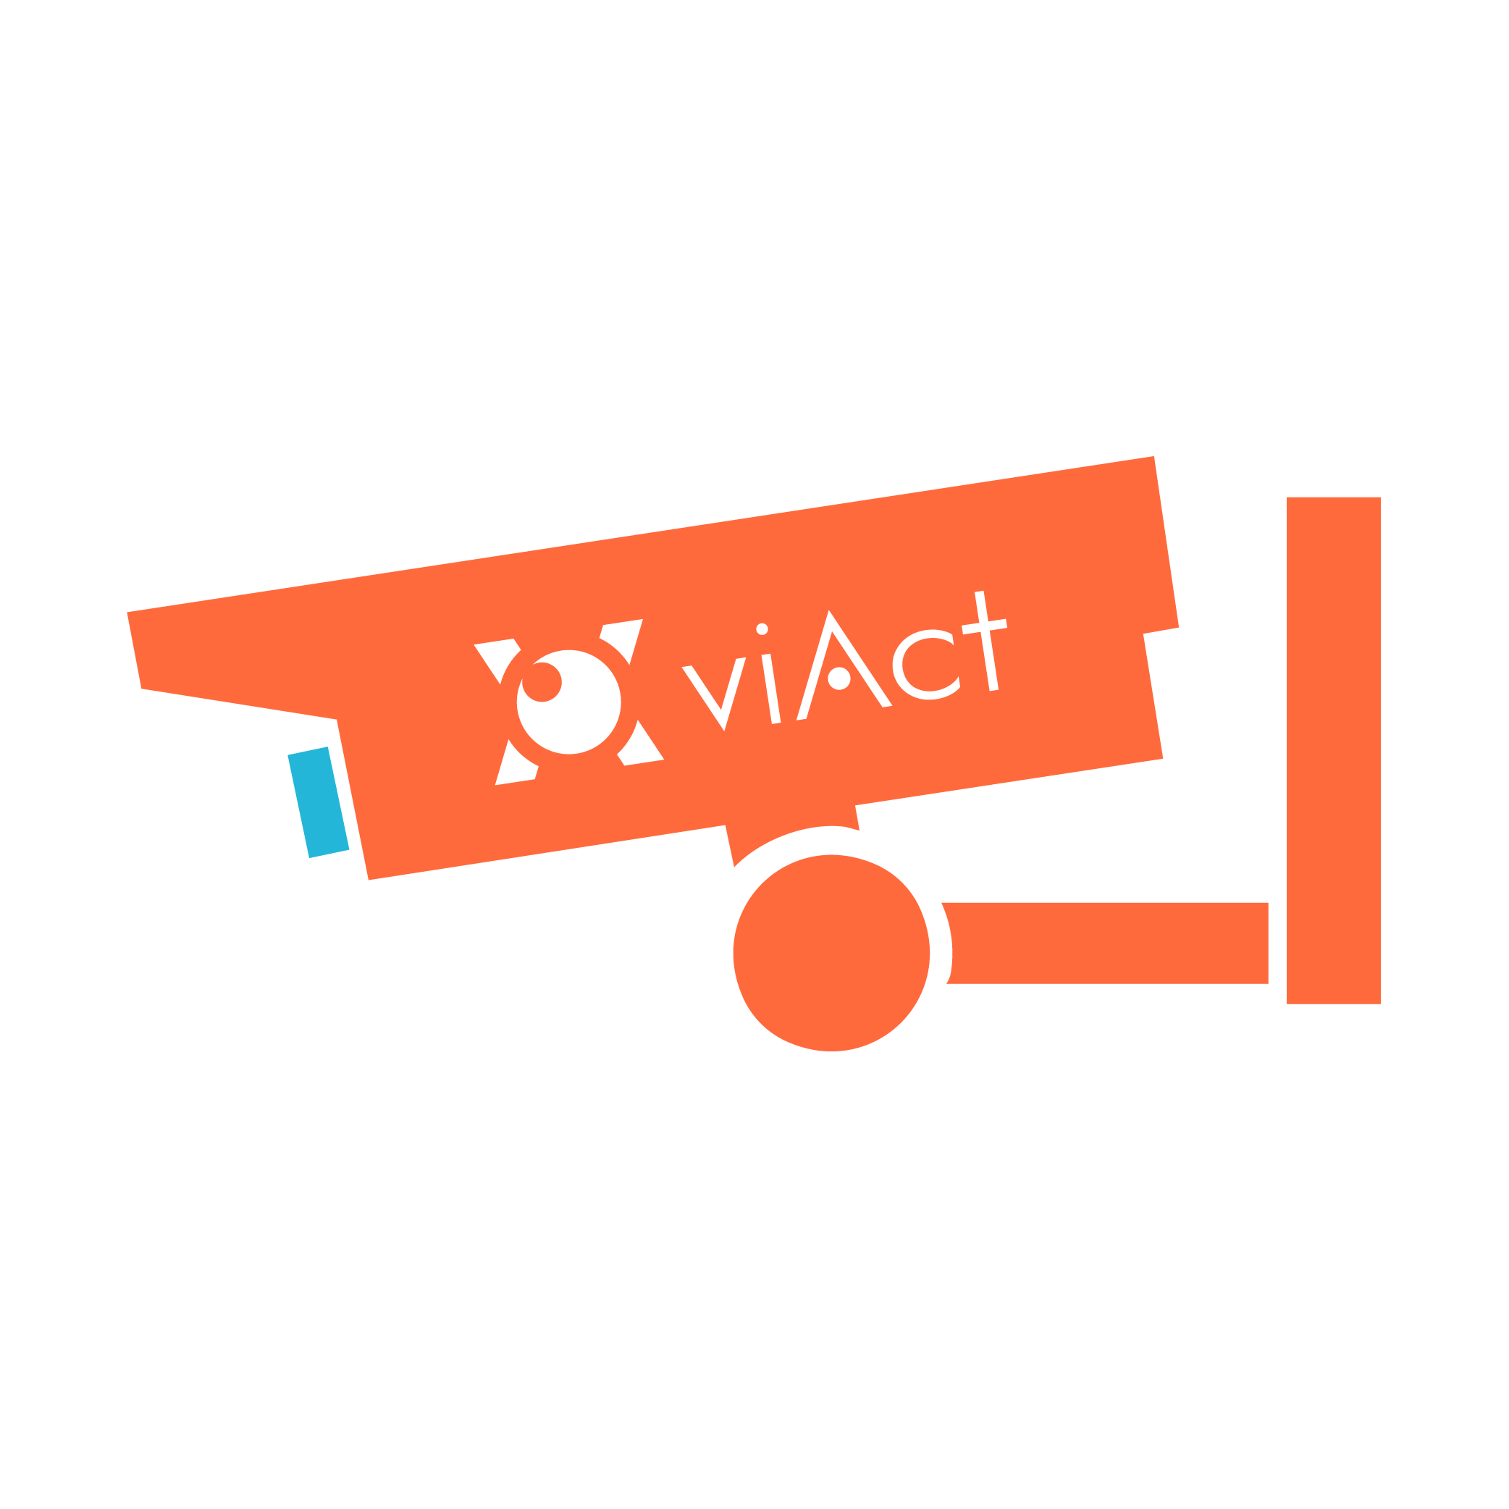

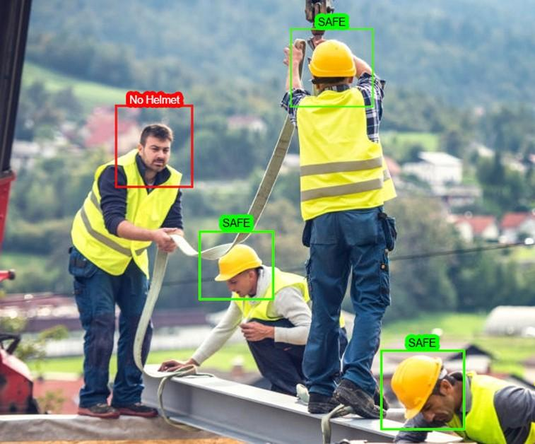
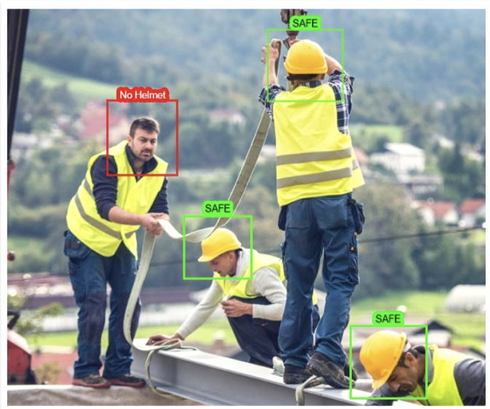
Email Notification
Alert & Report
Email notification will be sent once the non-compliant behavior has been detected by AI system

Slide 13
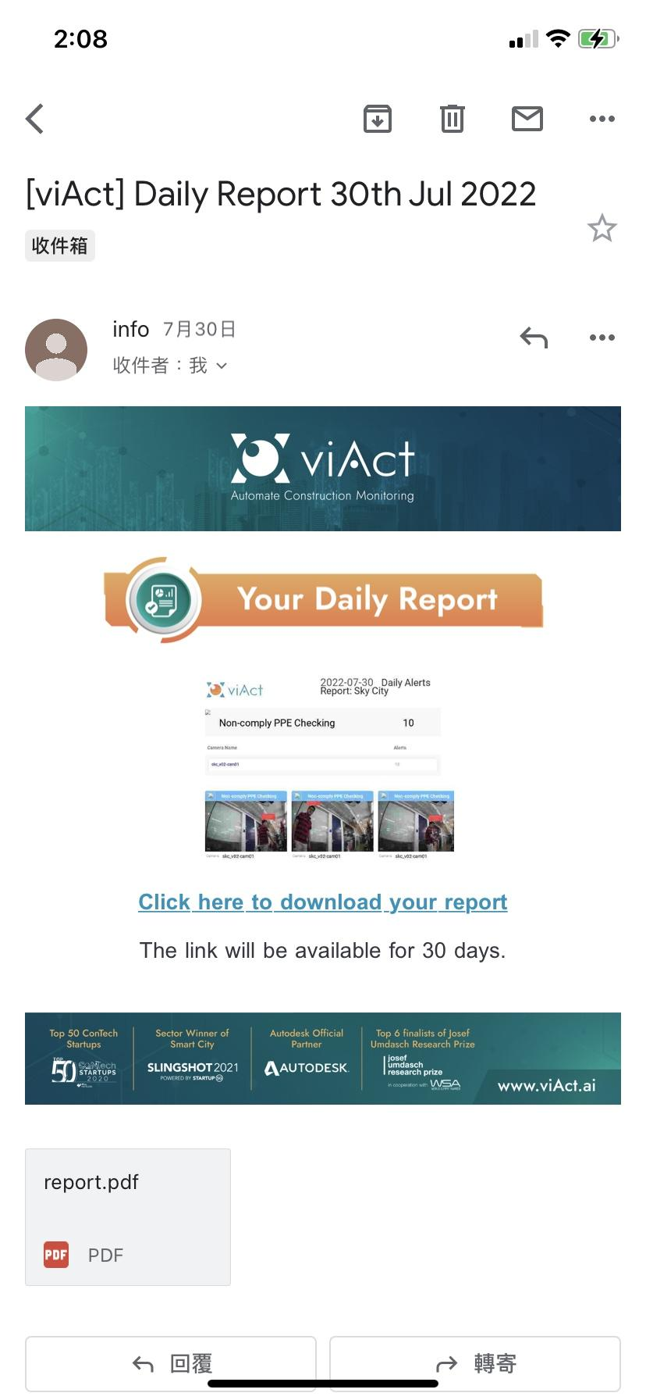
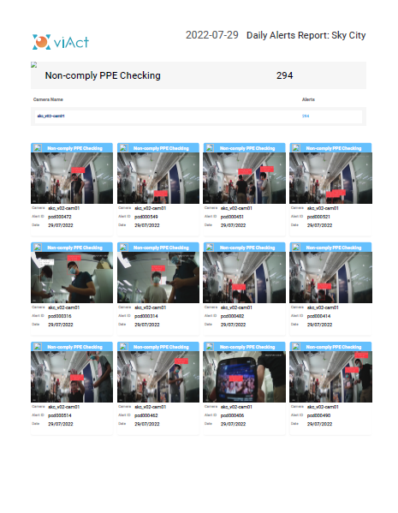
Daily Summary Report
Daily Summary Report will be sent everyday at 8pm

Slide 14
Support & Compliance

Slide 15








Ignite your Safety monitoring with a Partner by Your Side
Meet your viAct Team
Technical Consultant
Customer Success Lead
Software Lead
Account
Manager
Duke Tran - 8 YOE.
Integration & tech consultancy & Project coordination
Wayne Nguyen - 15 YOE
Project management guidance & escalation
Harry Pham - 13 YOE
Hands on deployment & support
Christine Ha - 10 YOE
Commercials & support & new adoption
Integration & Onboarding
Ever Success
Deployment Lead
Head of AI
Customer Success
Lead
Executive Sponsor
Product Lead
Tony Ng - 16 YOE
Your expert deployment of AI modules
David Nguyen - 18 YOE
AI consultancy, customization, adoption strategy
Wayne Nguyen - 15 YOE
Solution Delivery & success
Gary Ng - viAct’s CEO - 18YOE
Executive Stakeholder & Escalation
Vincent Pham - 12 YOE Product optimization & update

Slide 16

Dedicated Support When You Need It
Standard Support Hours
Our dedicated support team is available from 8:00 AM to 6:00 PM GMT+7 to assist with all your queries and system requirements.
24/7 Emergency Support
For critical (P1) issues that impact safety or operational continuity, our on-call team provides 24/7 support to ensure immediate response and resolution.
We ensure that expert assistance is always within reach, supporting your operations around the clock for urgent matters.

Slide 17



Prioritizing Your Uptime: Our SLA Matrix
Critical (P1)
High (P2)
Complete system outage, AI module failure affecting safety alerts, or dashboard down.
Key component malfunction (e.g., facial recognition not working intermittently).
Response: within 1 hour
Response: within 4 hours
Resolution: within 4 hours
Resolution: within 1 business day
Medium (P3)
Low (P4)
Degraded system performance, intermittent bugs, or partial dashboard errors.
Cosmetic UI issues, general feature requests, or documentation questions.
Response: within 1 business day
Response: within 2 business days
Resolution: within 3 business days
Resolution: next scheduled update
Our Service Level Agreement (SLA) is designed to address issues with speed and efficiency, minimizing disruption to your critical operations.

Slide 18

GDPR Compliance: Protecting Your Data
viAct is fully committed to upholding the highest standards of data privacy and protection. We ensure complete compliance with the General Data Protection Regulation (GDPR) across all AI and RTLS modules deployed at the client's sites.
"Safeguarding personal data is not just a regulatory requirement; it's a cornerstone of trust and operational integrity."

Slide 19
Core Principles of Data Protection
Data Minimization
User Consent & Transparency
Data Subject Rights
We collect only essential data, such as location and heart rate, strictly adhering to the principle of purpose limitation.
We fully support individuals' rights to access, correct, delete, and port their personal data, empowering them with control.
Explicit consent is obtained for biometric data usage, including facial recognition and health data, ensuring transparency with all users.
Our data handling policies are built on robust principles designed to protect individual privacy and maintain compliance with global standards.

Slide 20

Secure Processing & Storage
Data security is paramount. We employ end-to-end encryption for data at rest and in transit, utilizing industry-leading standards such as AES-256 and TLS 1.2+.
Role-based access controls further restrict data access, ensuring that only authorized personnel can view or manage sensitive information.
These measures create a secure environment for all data, from collection to storage, safeguarding against unauthorized access and breaches.

Slide 21



Robust Governance & Risk Management
Regular Internal Audits
Data Protection Impact Assessments (DPIAs)
We conduct frequent internal audits to continuously assess and improve our data protection practices and ensure ongoing compliance.
DPIAs are performed for all new systems and significant changes, proactively identifying and mitigating potential privacy risks.
Our proactive approach to governance and risk management guarantees that your data is handled responsibly and securely throughout its lifecycle.

Slide 22
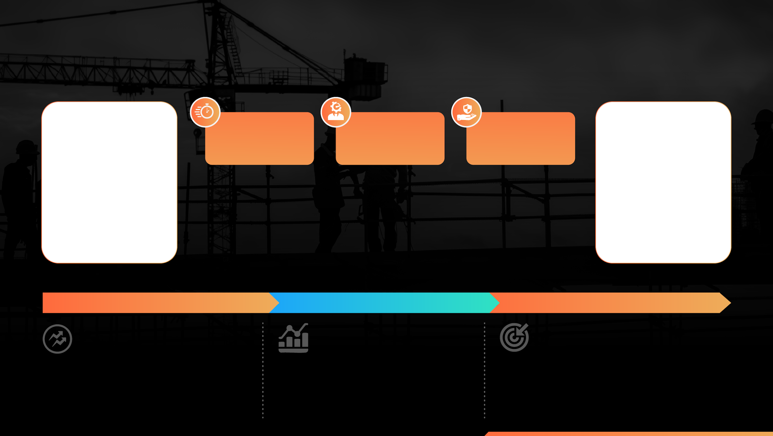
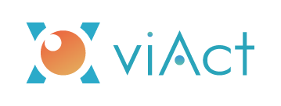
Post Deployment Performance Matrix
95% Decrease in Safety Incidents
100% Referenceable AI-driven Safety Monitoring
75% Increase in Productivity
35% Faster
1000+ Man-hours
Over 3000
incident detection and response time compared to traditional methods.
Saved Daily through AI- powered automation
Safety Events analyzed per month to generate actionable insights.
3000 TB+ Data Analyzed
15K+ Violations Detected per Site
200+ Critical Risks Averted
#1 SAFETY
With AI-driven insights with viAct’s 4S, sites experience a measurable shift in safety culture, leading to proactive risk management and an 95% enhanced safety.
#2 PRODUCTIVITY
By automating workforce tracking, sites have optimized manpower allocation, increasing available man-hours without additional labor.
#3 QUALITY
Built on years of AI training, viAct’s 4S system ensures visual assessment enhancing quality control, ensuring fewer operational risks and improved compliance adherence.
TRENDS
STATISTICS
OUTCOME
viAct’s 4S reduces data variability with standardized templates, enabling proactive hazard identification, risk assessment, and automated actions—leading to an 85% decrease in high-risk incidents.
viAct’s 4S cuts paperwork by 75% for the safety teams for better accuracy by auto-calculating risk scores and enhancing risk control insights for better safety planning.
1,500–3,000 hours of worker exposure to hazards reduced monthly by viAct’s 4S, ensuring collaborative visibility and data-driven safety decisions with customizable dashboards, helping EHS teams.
Notes:
Our deployments produce measurable outcomes: 95% decrease in safety incidents, 75% productivity uplift, 35% faster incident detection & response, thousands of TB analyzed and thousands of violations detected per site. These figures reflect sustained, operational deployments where safety and uptime are mission critical

Slide 23
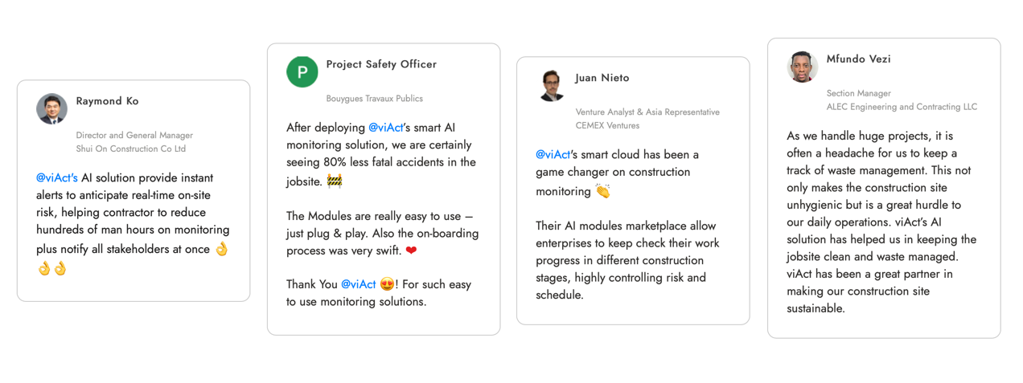
Customer Testimonials
“Reduce hundreds of man hour”
“Game changer on construction monitoring”
“Make construction site Sustainable”
“80% less fatal accidents”
Notes:
Clients call viAct a ‘game changer’ — reporting fewer accidents, hundreds of man-hours saved, and an overall uplift in operational confidence. These quotes reflect real operational improvements from our deployed sites.

Slide 24
COMMERCIAL & RESIDENTIAL PROJECTS
Redevelopment of Queen Mary Hospital, phase 1
Redevelopment of Kwai Chung Hospital, phase 2
Multi-welfare services complex in Kwu Tung North
Public housing development at Chai Wan
Two, Tai Koo Place Grade A Office
MTR East Rail Line Cross-Harbour Extension HKCEC Station
FACILITE MANAGEMENT & SMART CITY PROJECTS
Tseung Kwan O Area 137 Fill Bank
Tuen Mun Area 38 Fill Bank
Tuen Mun Area 38 Temporary Construction Waste Sorting Facility
MTR Kowloon Bay Depot
CLP Castle Peak Power Station
CLP Black Point Power Station
HK Electric Ap Lei Chau Tower
DSD To Kwan Wan Sewage Pumping Station
DSD Kowloon City Sewage Pumping Station
EPD illegal dumping black spots
Job Reference
GOVERNMENT PROJECTS
DC/2018/03
Expansion of Sha Tau Kok Sewage Treatment Works Phase 1 and Village Sewerage in Tong To
DC/2018/05
Relocation of Sha Tin Sewage Treatment Works to Caverns –Site Preparation and Access Tunnel Construction
DC/2018/07
Shek Wu Hui Effluent Polishing Plant - Main Works Stage 1 - Civil Works for Sewage Treatment Facilities
DC/2019/03
Revitalisation Works of Jordan Valley Nullah and Minor Drainage and Sewerage Works in Urban Area and New Territories
ED/2018/04
Trunk Road T2 and Cha Kwo Ling Tunnel
GE/2019/01
Landslip Prevention and Mitigation Programme, 2019, Package K, Landslip Prevention and Mitigation Works in Hong Kong Island, Kowloon, New Territories and Outlying Islands
HY/2014/07
Construction of tunnels under the seabed of Kowloon Bay and at Ma Tau Kok, and depressed roads and underpass at Kai Tak Development
HY/2018/02
Construction of at-grade roads, bridges and Kai Tak Interchange from Central Kowloon Route to road networks in Kai Tak Development and Kowloon Bay
HY/2018/08
Construction of central tunnel, cut-and-cover tunnels at Yau Ma Tei and Ma Tau Kok, piles and diaphragm walls for Ho Man Tin ventilation building
HY/2019/13
Construction of administration building and ventilation buildings, and installation of route-wide electrical and mechanical works

Slide 25
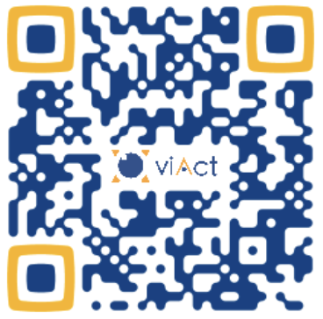



Contact us to know more
viAct Website
viAct Twitter
viAct Youtube
viAct LinkedIn

